Slide 1
Fireball!
Game Art Bible

Slide 2
Overview
“Team up with or against your friends in the Baby Dragons’ Playgrounds as you Fireball critters for the highest score in this action-packed party game!”
Fireball! is a multiplayer party game where players control cute baby dragons trying to kill cute little critters. We are using a cutesy, simplistic, and colourful visual style in order to best relay the cute and playful concept, while also taking advantage of it for a humourous contrast with the violent gameplay.
To make the experience more dynamic and hectic, we will have various powerups and a constant stream of critters. At the end of rounds, we will further add to the humour with gag achievements.

Slide 3
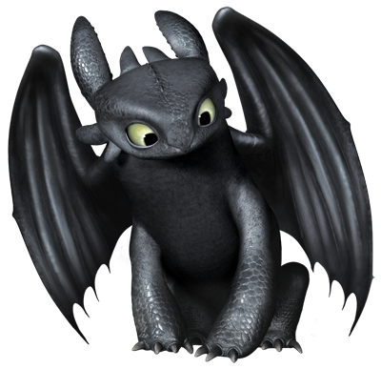
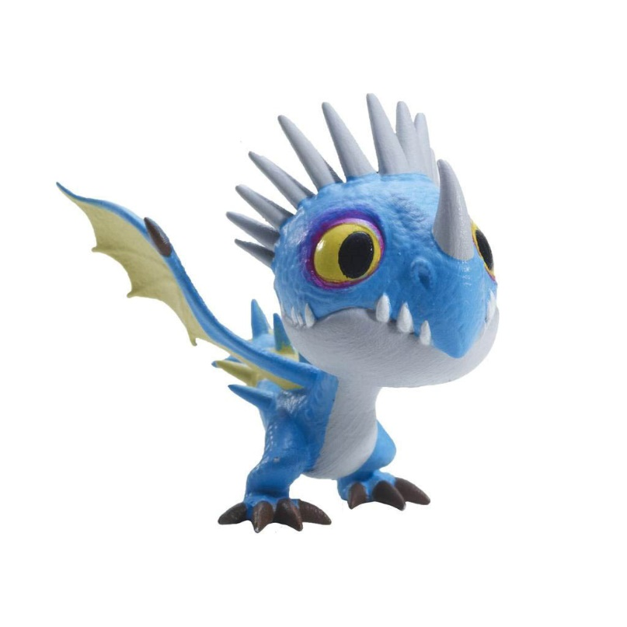
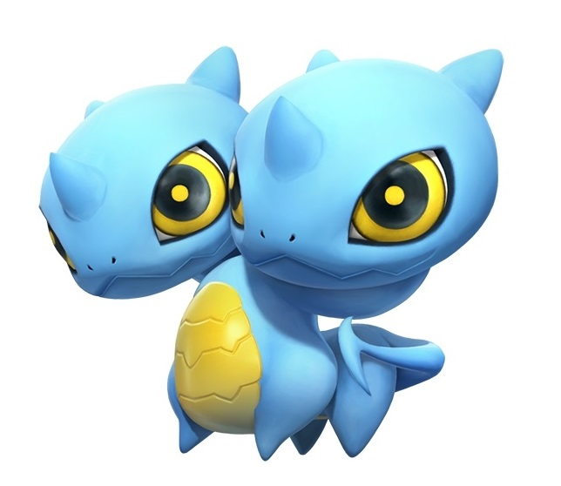
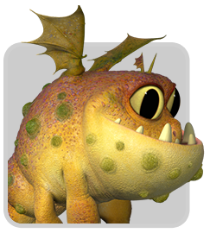
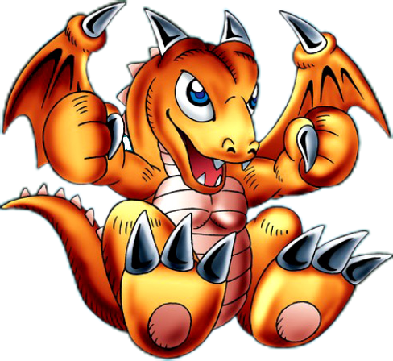
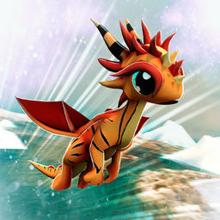
Character Style Guide
The idea behind the dragon designs is to have them be recognisably young as well as cute and cartoonish.

Slide 4
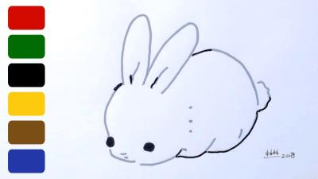
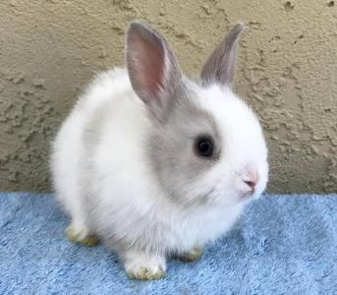
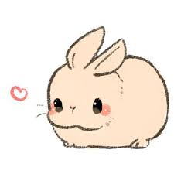
Character Style Guide
The critters should be completely adorable and look infant and helpless, to sell the cute visual and humourous morbidity of the gameplay.

Slide 5
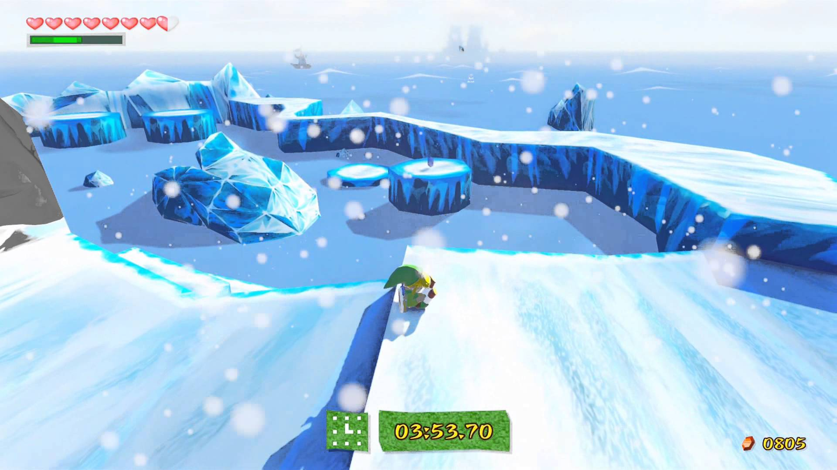
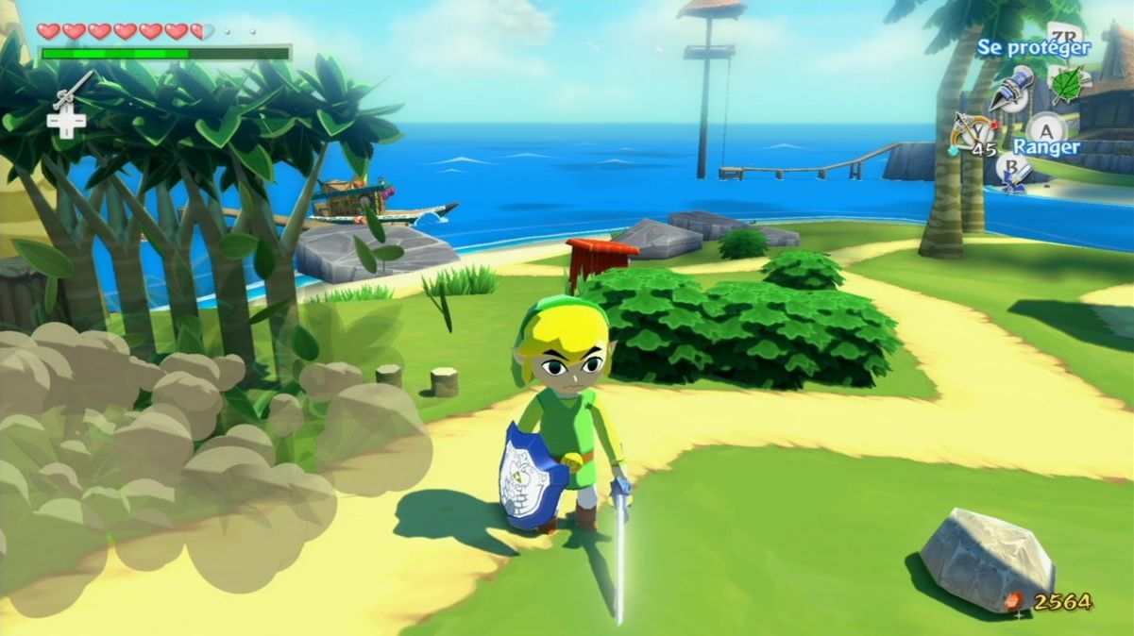
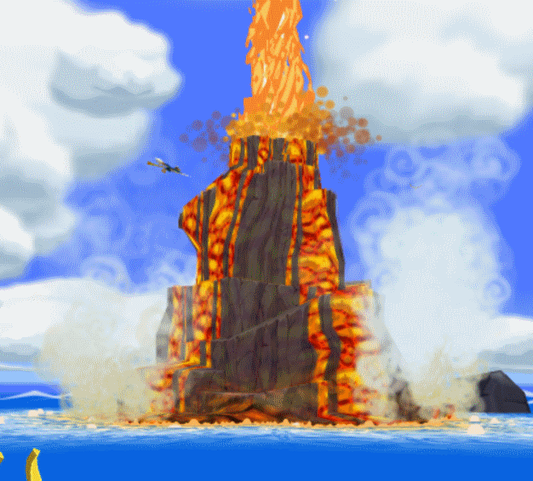
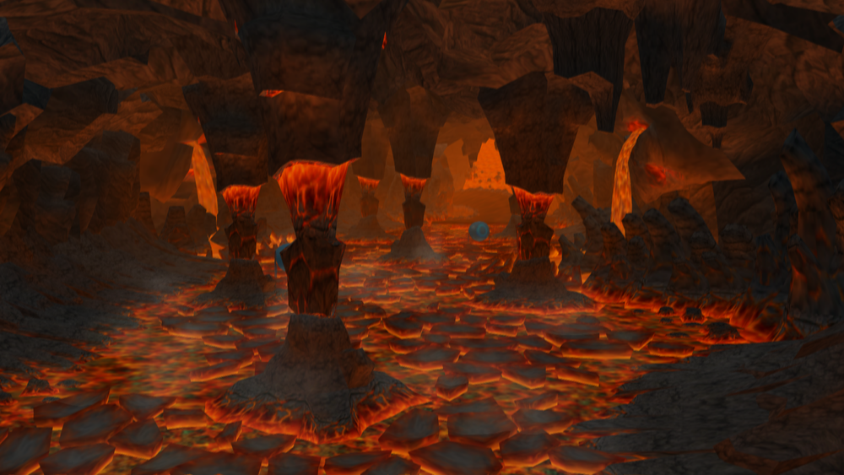
Environment Style Guide
The environments are cartoony and simplistic. Environment assets lean toward being more angular than perfectly smooth.

Slide 6
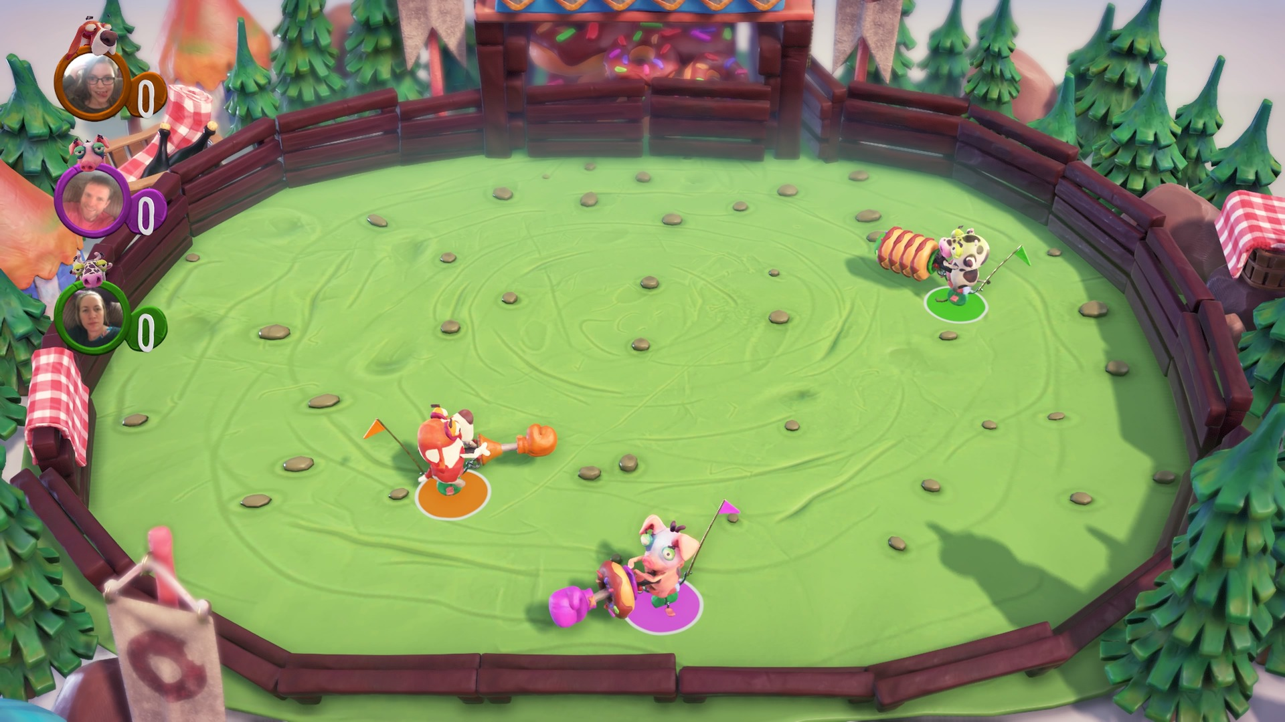
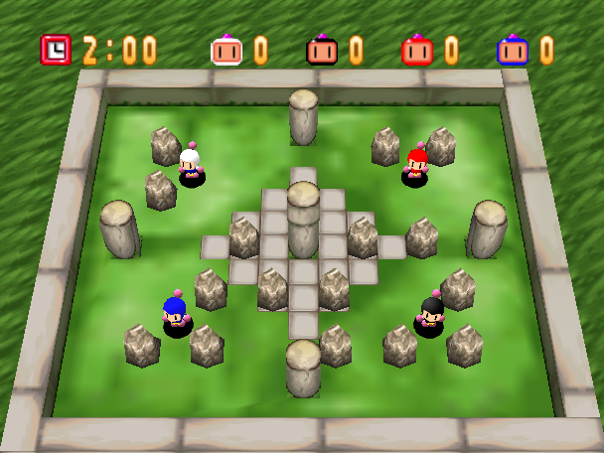
Environment Style Guide
The camera angle will be fixed at a slanted top-down view. The stage is a walled-in area that holds all the gameplay inside it.

Slide 7
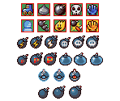
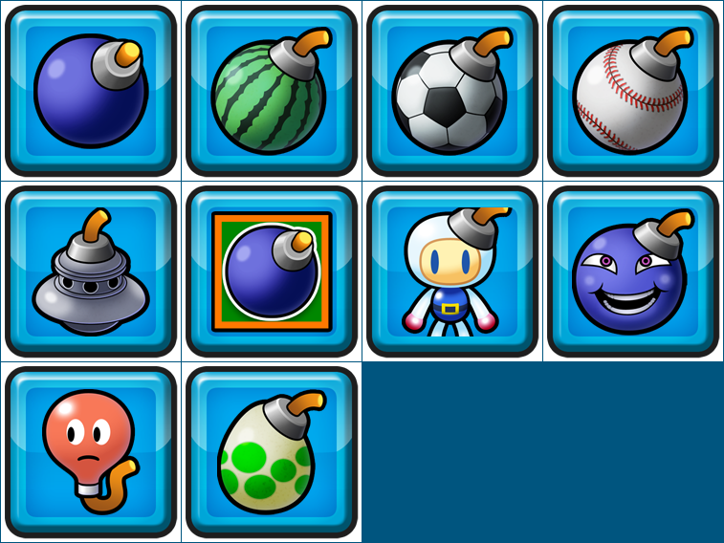
Powerup Style Guide
The common powerups will be 2D, and should be easily distinguishable among all the mayhem during the game. A bright outline around an appropriate image would be best for this.

Slide 8
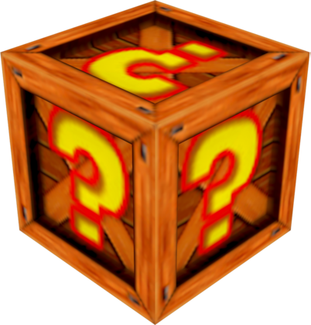
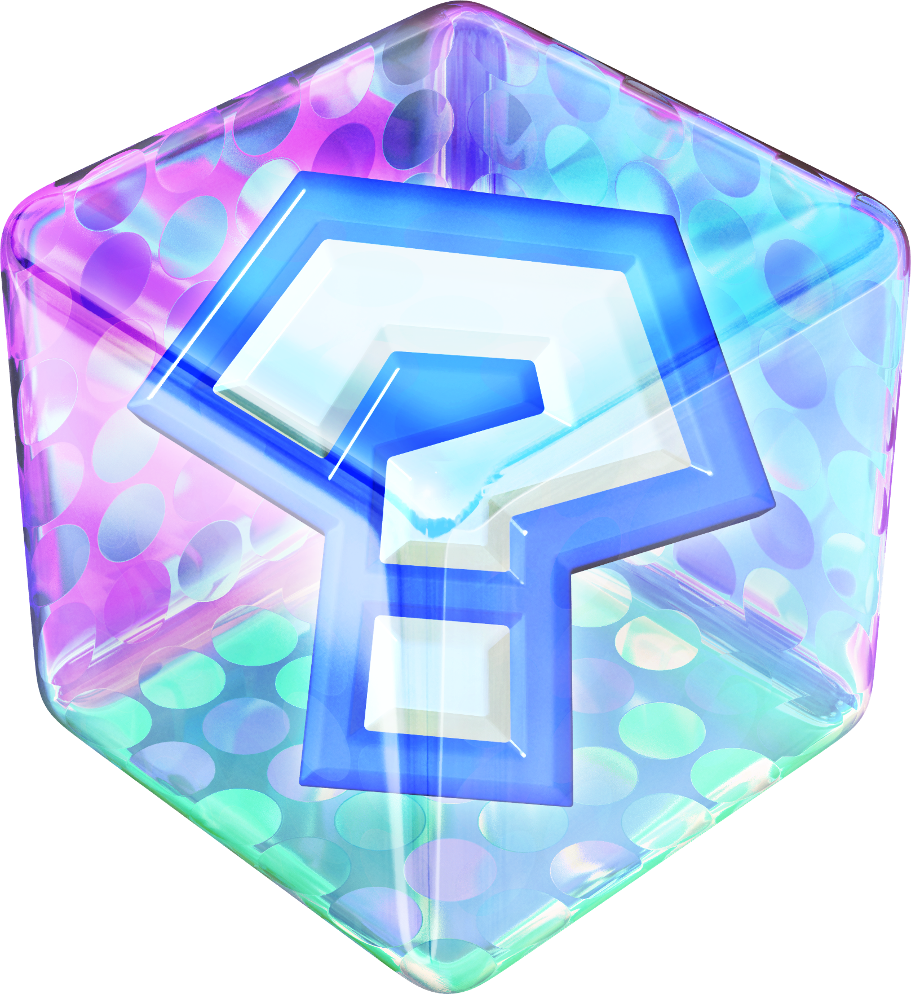

Powerup Style Guide
The special powerups will be randomized, and the player will receive one of several upon picking up the powerup. The special powerup will be a 3D object and incredibly noticeable. All of them will have a significant impact on the playing field.

Slide 9
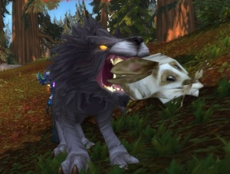
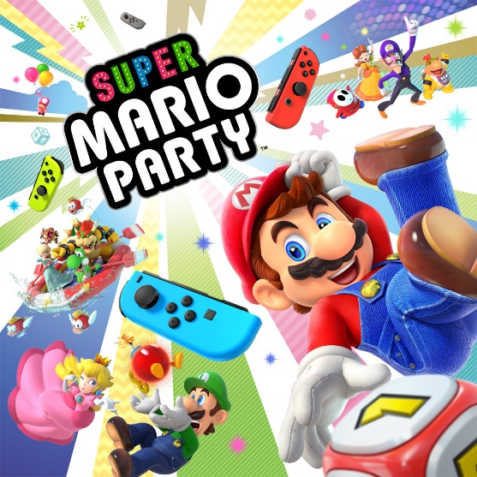
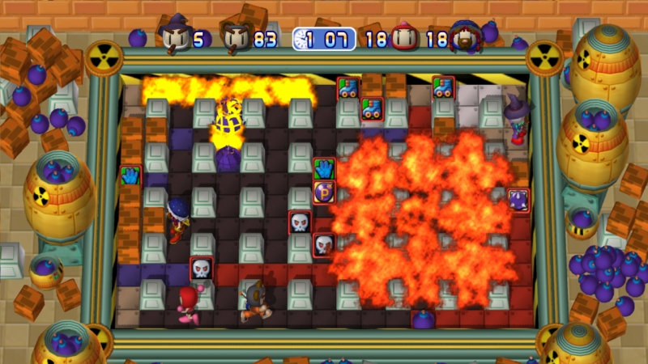
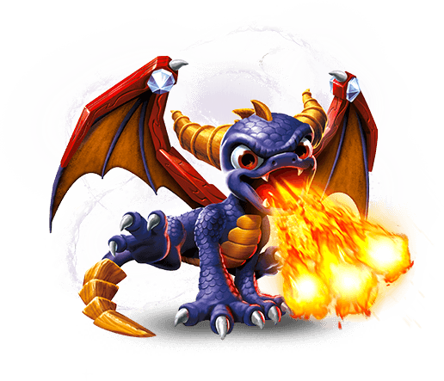
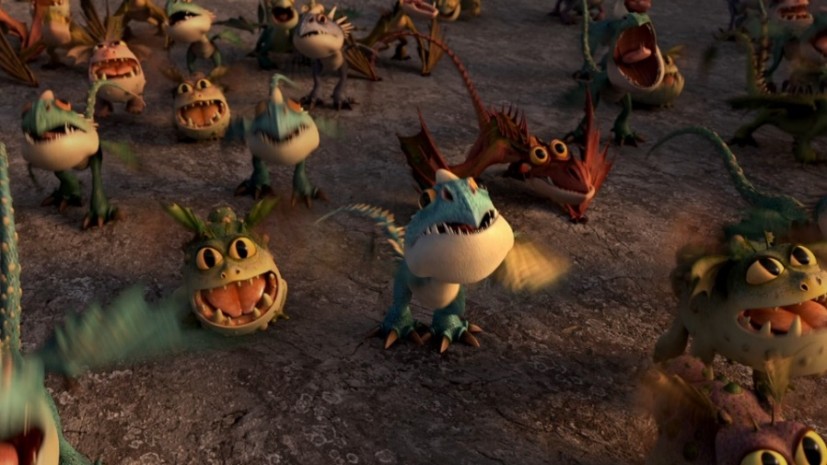
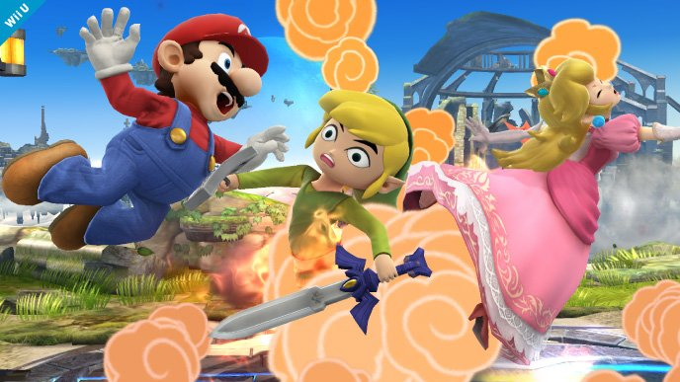
Game Moodboard
The game is colourful and ostensibly family-friendly, but also slightly morbid. It’s a hectic and violent experience while maintaining a cute exterior.

Slide 10
UI Design Concepts
Stage Select
Fireball!
Start
Instructions
Options
Exit
Fireball!
Fireball!
Instructions
Options
-------------
-------------
-------------
Option
Option
Option
Option
Option
Start
Instructions
Options
Exit
Start
Instructions
Options
Exit
2/3
Simple, intuitive layout for easy navigation of menus.

Slide 11
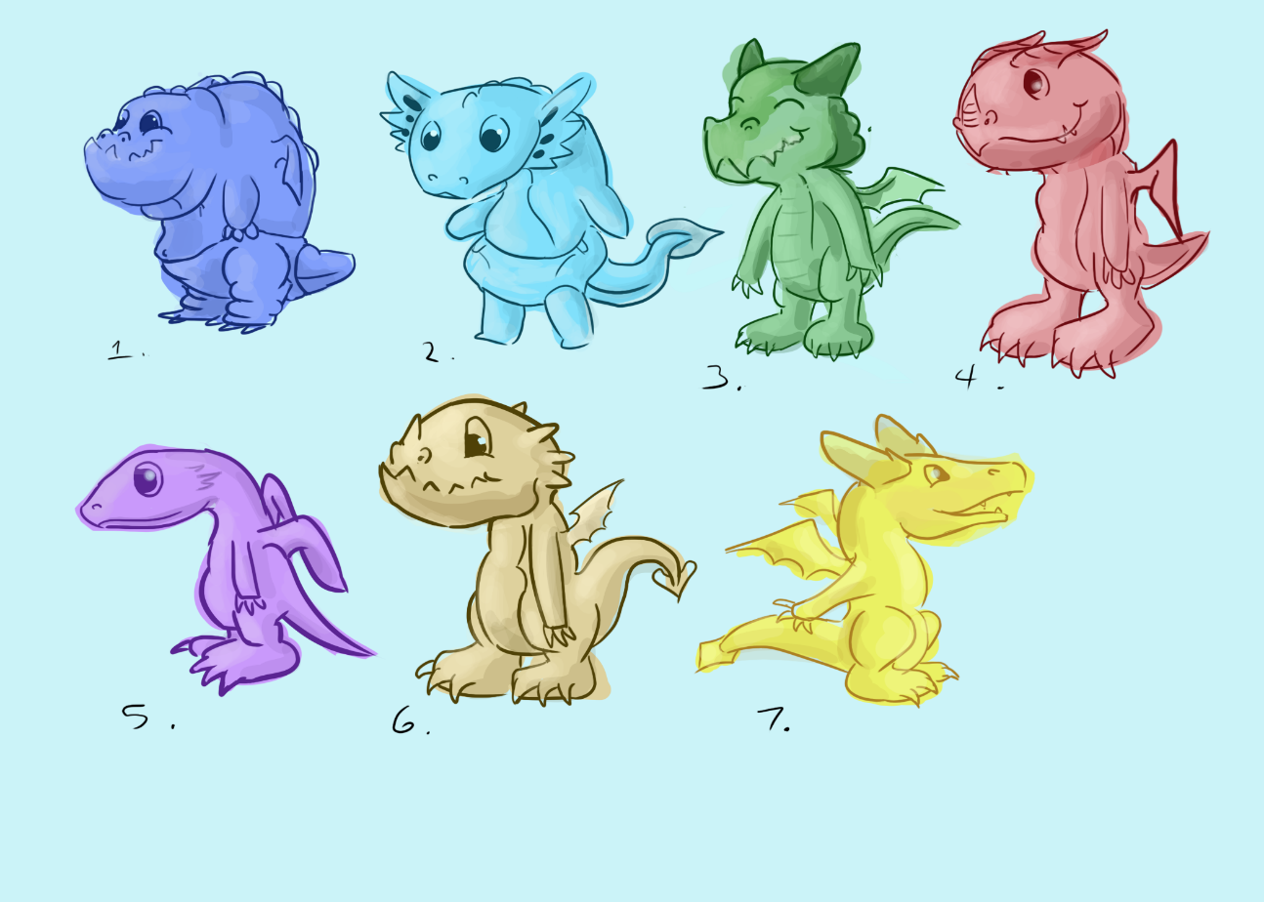
Character Thumbnails
We tested bipedal designs. Bipedal dragons would give more horizontal space to work with, but they seemed off and not “baby” enough.

Slide 12
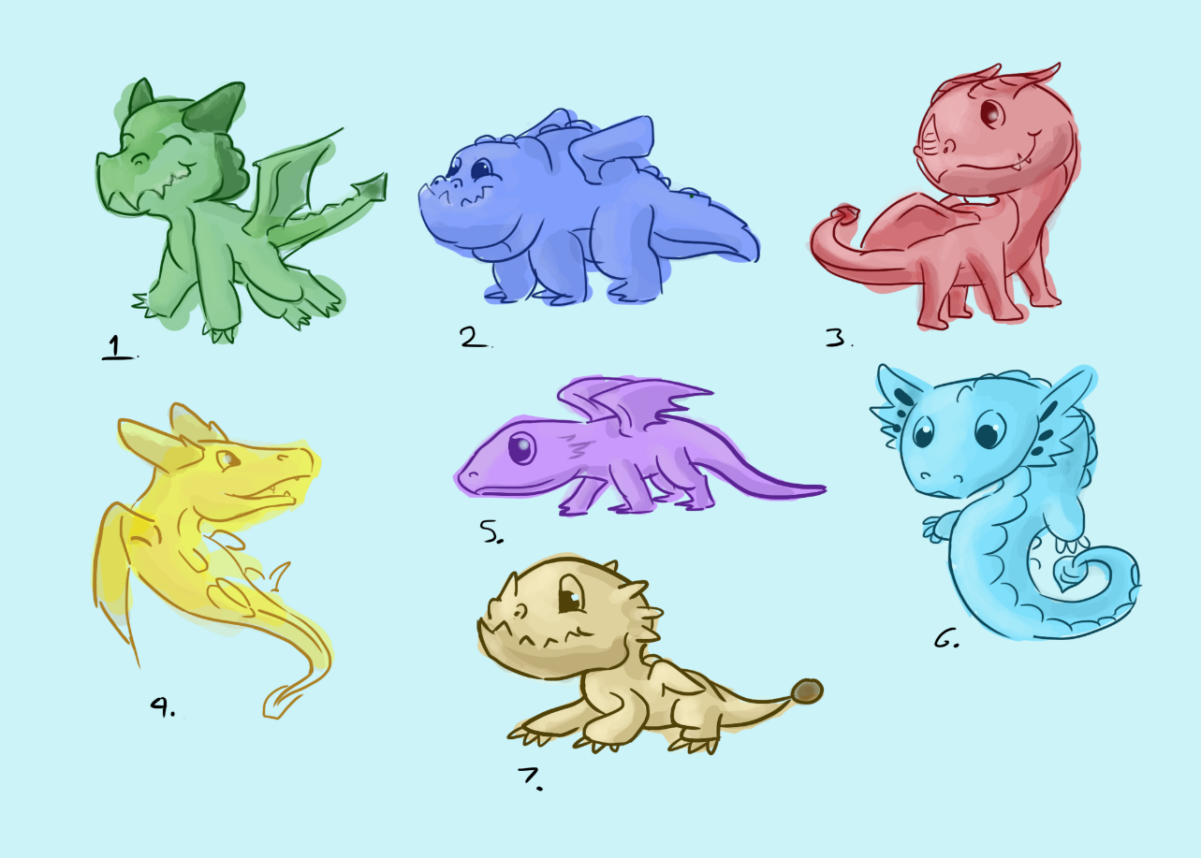
Character Thumbnails
The classic quadruped design looked more natural. It was also easier to make them look cute and more “baby” in this style.

Slide 13
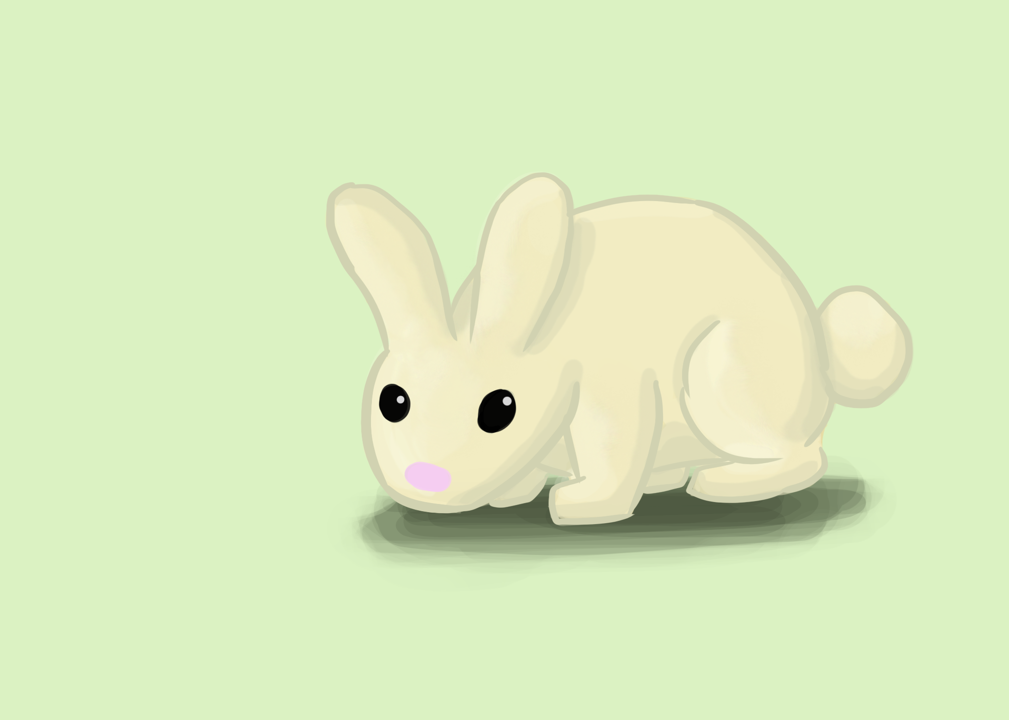
Character Thumbnails
First critter concept. We like the idea of using a bunny as the first helpless critter, but the design needs to be more infant.

Slide 14
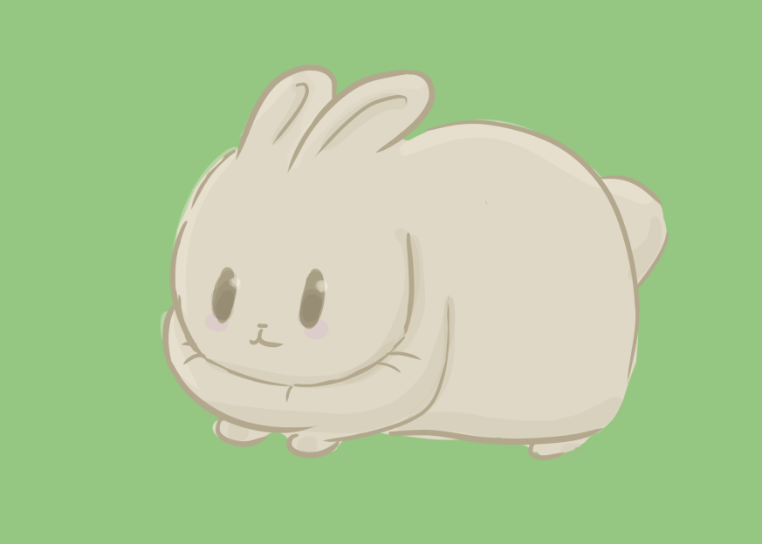
Character Thumbnails
Second critter concept. The round shape and simplified, cartoony features helps to sell the cute factor. The restricted limbs also makes it appear more helpless.

Slide 15
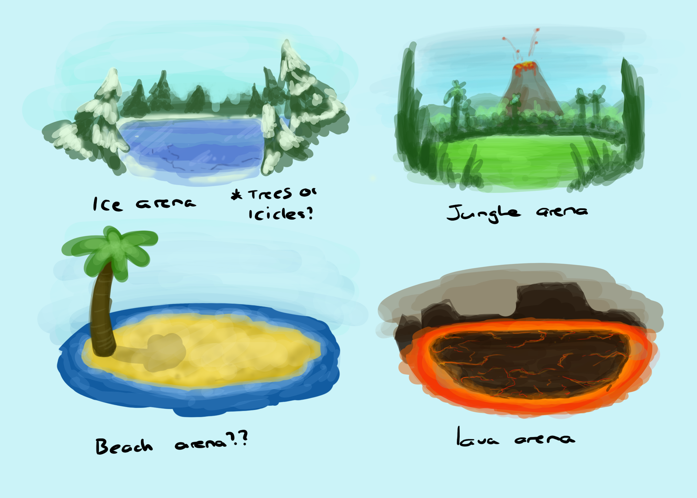
Environment Thumbnails
We are planning to eventually have multiple playable areas.
For a first area, we decided to have a more green and plain design.

Slide 16
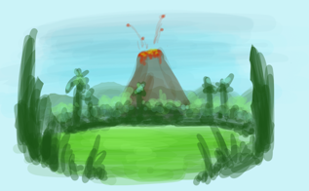
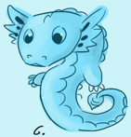
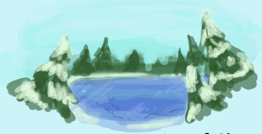
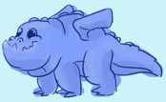
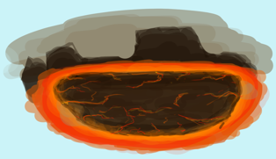
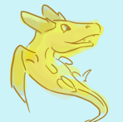
Colour Palette
Forest/Jungle map colours.
Ice map colours.
Firey/Volcanic map colours.
Dragons would go with these colour schemes as well.
Beach map colours.

Slide 17
Colour Palette
The colours for most of the powerups will involve red/oranges as they feature fire. The blues are used as a contrast for effects like speed lines and distinguishing the movement powerup from the projectile ones.

Slide 18
Artists & Roles
Name:
Wing Him Choi
Roles:
Environment models, Environment Texturing, Rigging, Animation, UV unwrapping
Name:
Tiarna Kilmister
Roles:
Concept Art (Character), Concept Art (Environment), Character models, Character Texturing, UV unwrapping

Slide 19
Asset List
Wing Him Choi:
Item: | Description:
Tree 1 | Fir tree, main tree for the forest
Tree 2 | Curved tree with two main bunches of leaves
Tree 3 | Palm tree, usable in either a jungle or beach setting
Rock 1 - 6 | Various different rocks for variety, to be placed around the environment
Environment pieces | Different environment pieces themed after different settings for multiple maps.
Environement textures | PBR textures done in Substance Painter for the environment assets
Ground texture | PBR texture done in Substance Painter for the flat ground
Character Rigs | The rigs and skinning for all the characters, to be used for animation
Character Animation | Looping animations for the characters, to be used where appropriate in the game

Slide 20
Asset List
Tiarna Kilmister:
Item: | Description:
Dragon 1 | A quadruped, fat baby dragon. Playable character.
Dragons | Other dragons with different designs. Playable characters.
Bunny | Main destroyable critter for the forest map.
Critters | Other destroyable critters themed after the maps they would be in.
Concept Art | Concept art for characters and environments.
Dragon textures | Handpainted textures for the dragons. Four colour variations, one for each potential player.
Bunny texture | Handpainted texture for the bunny. At least two colour variations for visual variety.
Critter textures | Handpainted textures for the other critters.

Slide 21
Platform Considerations
Our game will be on PC. On higher end, this has very few limitations aside from lack of touchscreen functionality. On the lower end, we would need to worry about file sizes and poly count to be able to support older hardware and software.
Our art pipeline will be standard as we’re working with PC. No special requirements or methods.
2D Assets:
File Name | Art Type: | Texture Resolution:
FB_[assetName]_UI | UI | 256 x 256
FB_[assetName]_Texture | Texture | 256 x 256
FB_[assetName]_AnimTexture | Animated Texture | 256 x 256
3D Assets:
File Name | Art Type: | Poly Count Limit:
FB_[assetName]_Prop | Prop | 200 - 400
FB_[assetName]_Char | Character | 500 - 1k
FB_[assetName]_Env | Environment | 50 - 500

Slide 22

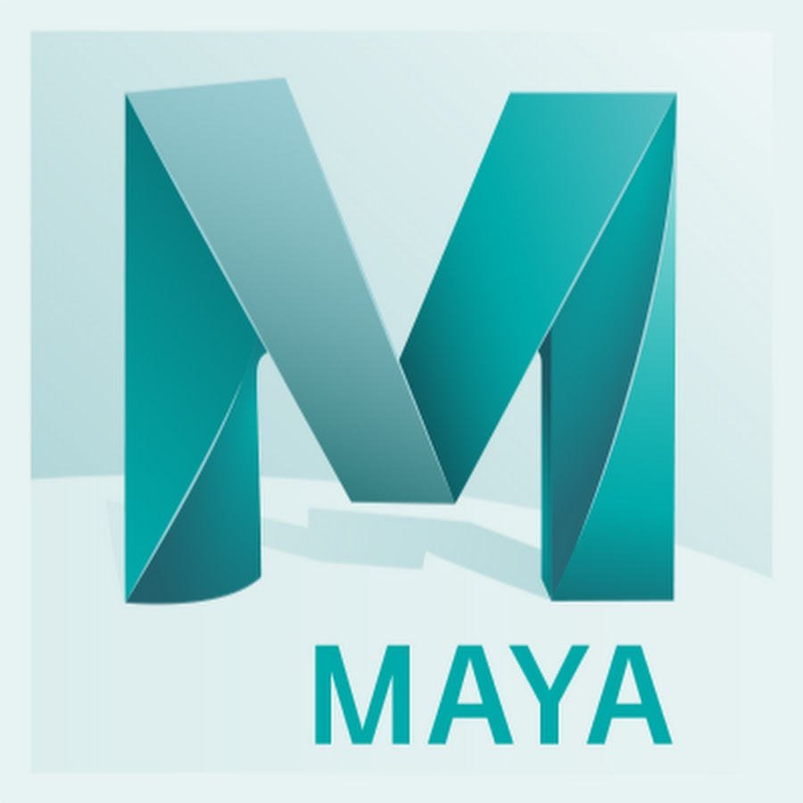

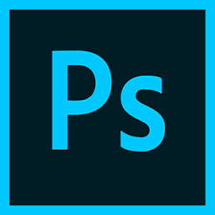
Software
Maya
ZBrush
Substance Painter
Photoshop
Maya is an industry standard software for modelling and animation. The artists are also trained in using it.
ZBrush is a commonly used a versatile sculpting software. The artists are also trained in its use.
Substanace Painter is a great piece of texturing software and works well with Maya. The artists have been trained on it.
Adobe Photoshop is also a good program for handpainted texturing and 2D drawing.

